Slide 1
Advanced Shading Techniques II
http://www.ozone3d.net/
© 2005 James K. Hahn 2010 Robert Falk

Slide 2
Shader Variations
Mandelbrot Set
Bump Mapping
Perlin Noise
© 2005 James K. Hahn 2010 Robert Falk

Slide 3
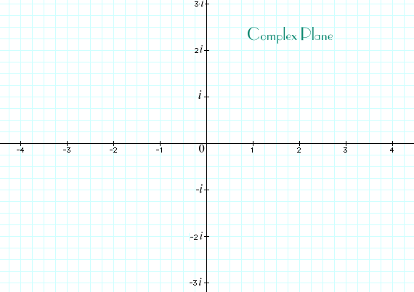
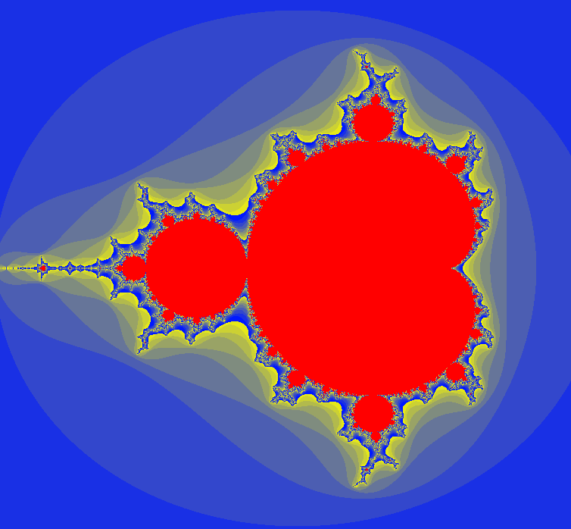
Mandelbrot Set
http://www.clarku.edu/~djoyce/complex/plane.html
Fractal curve
Based on complex numbers
  (a + bi)
Visualize on complex plane
Square a number repeatedly:
  converges=>in
  diverges=>out
Hearn & Baker 712..717
  Ignore cpu implementation
© 2005 James K. Hahn 2010 Robert Falk
Notes:
Note the defined range of he set (-2.5, -2.5)..(2.5, 2.5)

Slide 4
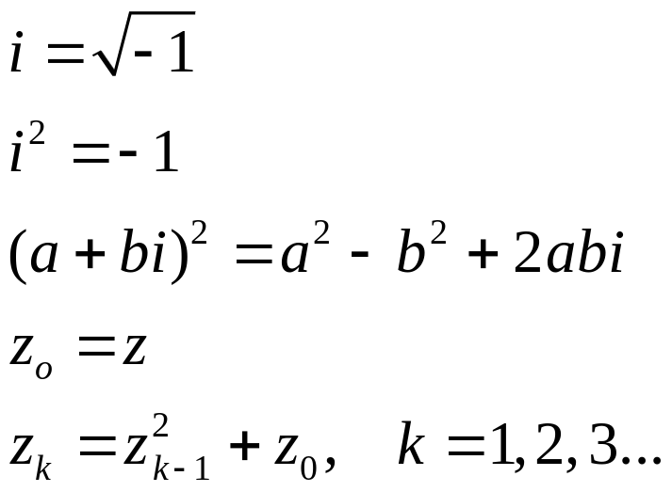
Mandelbrot Set
Initial Points ‘z’ are set to a point ‘a+bi’ in complex plane
If magnitude > 2 it always diverges (if sqrt(a*a +b*b) >2.0)
Pick interior color for all numbers that converge
Otherwise pick color based on number of iterations before divergence
© 2005 James K. Hahn 2010 Robert Falk

Slide 5
Mandelbrot Set
CPU SIDE: draw a quad
glUseProgram(mandelbrot_program);
glMatrixMode(GL_PROJECTION);
glLoadIdentity();
glOrtho(0.0, 1.0, 0.0, 1.0, -1.0, 1.0);
glMatrixMode(GL_MODELVIEW);
glLoadIdentity();
// Texture coordinate s,t => a,b
glBegin(GL_QUADS);
glMultiTexCoord2f(0, 0.0f, 0.0f);
glVertex3f(0.0f, 0.0f, 0.0f);
glMultiTexCoord2f(0, 1.0f, 0.0f);
glVertex3f(1.0f, 0.0f, 0.0f);
glMultiTexCoord2f(0, 1.0f, 1.0f);
glVertex3f(1.0f, 1.0f, 0.0f);
glMultiTexCoord2f(0, 0.0f, 1.0f);
glVertex3f(0.0f, 1.0f, 0.0f);
glEnd();
© 2005 James K. Hahn 2010 Robert Falk

Slide 6
Mandelbrot Set
Vertex Shader: Pass in tex coord scaled to overlap whole set
varying vec2 position;
void main()
{
position = gl_MultiTexCoord0.st*4.0 - 2.0;
gl_Position = ftransform();
}
© 2005 James K. Hahn 2010 Robert Falk
Notes:
If you choose, you can of course add shading based on usual lighting equations.

Slide 7
Mandelbrot Set
Fragment: Square each pixel (tex coord) to see if its in the set
varying vec2 position;
const float max_iterations=100.0;
const float zoom = 1.0;
const vec2 center = vec2(-0.5, 0.0);
void main()
{
vec3 color = vec3(1.0f, 0.0f, 0.0f); // inner color
float real = position.x * zoom + center.x;
float imag = position.y * zoom + center.y;
float cReal = real;
float cImag = imag;
float iter, r2 = 0.0;
// If sqrt(a*a+b*b) > 2, diverge (stop loop)
for (iter = 0; iter < max_iterations && r2 < 4.0; ++iter)
{
float tempreal = real;
real = (tempreal * tempreal) - (imag * imag) + cReal;
imag = 2.0 * tempreal * imag + cImag;
r2 = (real*real) + (imag*imag);
}
// Base the color on the number of iterations.
if (r2 >= 4.0)
color = mix(vec3(0.0,0.1,1.0), vec3(1.0,1.0,0.0), fract(float(iter)*0.1));
gl_FragColor = vec4 (clamp(color, 0.0, 1.0), 1.0);
}
© 2005 James K. Hahn 2010 Robert Falk

Slide 8
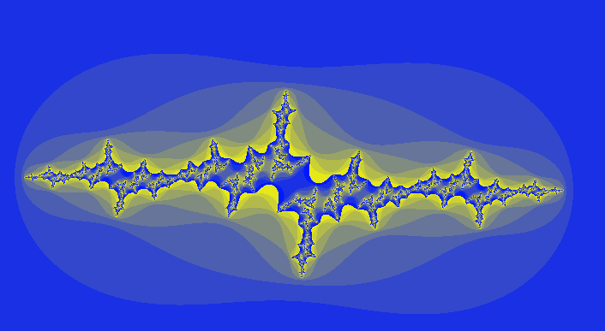
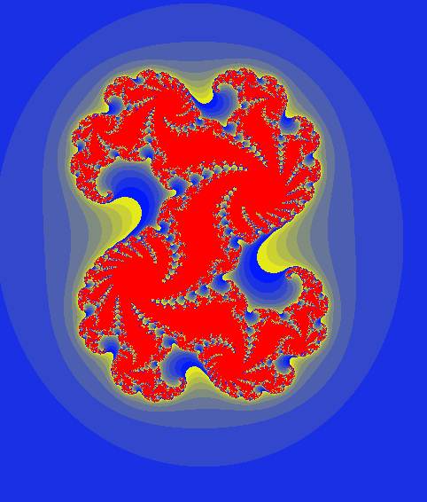
Mandelbrot Set
Julia Set: Set fixed values
for initial positions instead of
adding back a+bi.
.....
void main()
{
...
float cReal = -1.36; // 0.32
float cImag = 0.11; // 0.043
...
}
© 2005 James K. Hahn 2010 Robert Falk

Slide 9
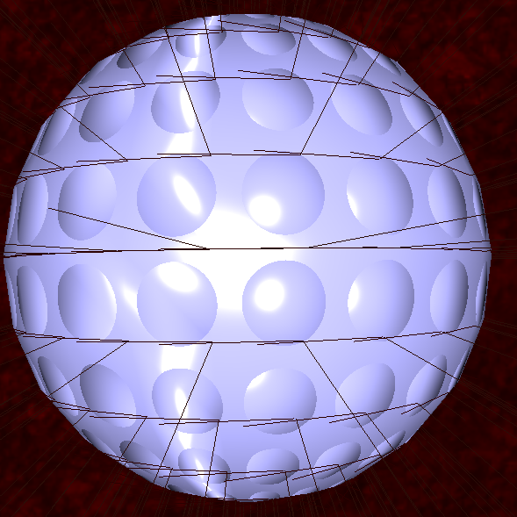
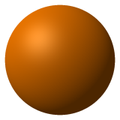
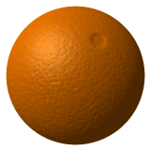
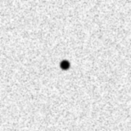


Bump Mapping
Use a texture to displace surface geometry
Only displace the normals, not the actual vertices
Changes interaction of light with the object at each pixel
Same effect with (huge numbers) of polygons would be much more expensive
Silhouette is still flat
orange: http://en.wikipedia.org/wiki/Bump_mapping
10
© 2005 James K. Hahn 2010 Robert Falk
Notes:
In book, chapter 22, p. 689

Slide 10
Bump Mapping
Repeating bumps (e.g. golf ball surface) can be done procedurally
Non-procedural objects require color map plus a bump (or normal) map.
Normal map stores normal displacement in r,g,b values. (0,0,1) => no displacement
How do we map displacements on 2D
texture to real-world object?
10
© 2005 James K. Hahn 2010 Robert Falk
Notes:
Think of wrapping a 1D set of normals around a sphere. (think of 4 normals on a line over a circle)

Slide 11
Bump Mapping
Define a local coordinate system for each vertex
Create from the normal, tangent and binormal(normalxtangent)
Infinite number of possible tangents at each vertex
Pick one that can be interpolated smoothly across the model to avoid artifacts between vertices
Define tangent in direction of local texture coordinate (e.g. s+)
Normals
Tangents
10
© 2005 James K. Hahn 2010 Robert Falk
Notes:
Binormal might more accurately be called bitangent

Slide 12
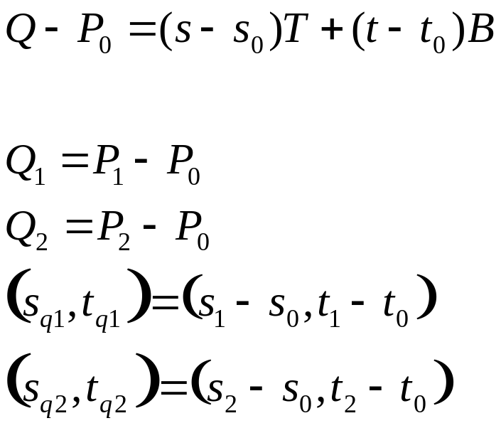


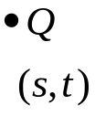

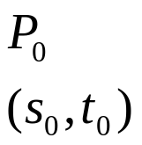
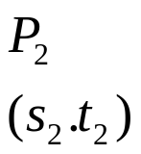
Bump Mapping
So given an object with texture coordinates, how do we find the smoothly-interpolated tangent?
Define mapping from tangent space to object space
n=(0,0,1) in tangent space maps to the normal in object space
Want tangent direction to map to ‘s’ and bi-normal to ‘t’
10
© 2005 James K. Hahn 2010 Robert Falk
Notes:
Map to the local 3D direction of ‘s’.

Slide 13
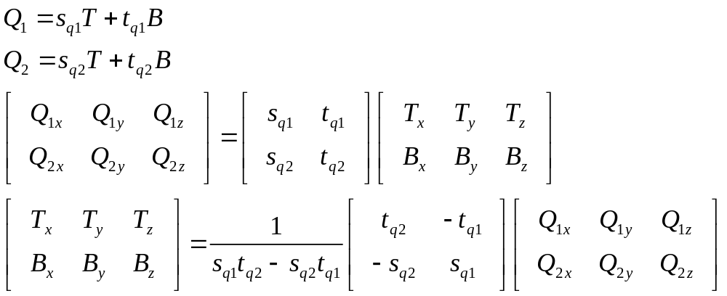
Bump Mapping
Solve linear system with 6 unknowns (the components of the tangent and binormal vectors)
Only need tangents to pass to shaders
Solve for each triangle
For each vertex, average tangents of connected tris
10
© 2005 James K. Hahn 2010 Robert Falk

Slide 14
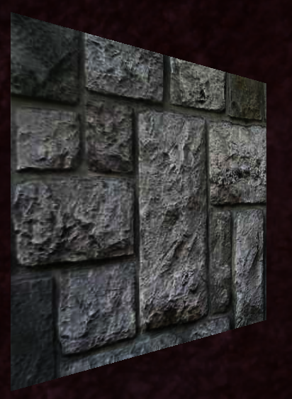
Bump Mapping
CPU Side - Set up textures, pass in tangents
glUseProgram(shader_program8);
glActiveTexture(GL_TEXTURE0);
glBindTexture(GL_TEXTURE_2D, m_bump_diffuse); //color texture
GLint loc = glGetUniformLocation(shader_program8, "diffuse_tex");
glUniform1i(loc, 0);
glActiveTexture(GL_TEXTURE1);
glBindTexture(GL_TEXTURE_2D, m_bump_normals); // normal texture
loc = glGetUniformLocation(shader_program8, "normal_map");
glUniform1i(loc, 1);
glBindAttribLocation(shader_program8, 1, "tan");
glBegin(GL_QUADS);
glNormal3f(0.0f, 0.0f, 1.0f);
glVertexAttrib2fv(1, Vec3(1.0f, 0.0f, 0.0f).getPtr() );
glMultiTexCoord2f(0, 0.0f, 0.0f);
glVertex3f(-1.0f, -1.0f, -1.0f);
glMultiTexCoord2f(0, 1.0f, 0.0f);
glVertex3f( 1.0f, -1.0f, -1.0f);
glMultiTexCoord2f(0, 1.0f, 1.0f);
glVertex3f( 1.0f, 1.0f, -1.0f);
glMultiTexCoord2f(0, 0.0f, 1.0f);
glVertex3f( -1.0f, 1.0f, -1.0f);
glEnd();
10
© 2005 James K. Hahn 2010 Robert Falk

Slide 15
Bump Mapping
Vertex Shader - xform lighting to tangent space
varying vec4 diffuse, ambient, specular;
varying vec3 normal, eye_dir, light_dir;
attribute vec3 tan; // attribute from cpu side
void main()
{
  // compute tangent and binormal in eye space
normal = normalize(gl_NormalMatrix * gl_Normal);
vec3 tangent = normalize(gl_NormalMatrix * tan);
vec3 binormal = normalize(cross(normal, tangent));
tangent = normalize(cross(binormal , normal));
// a matrix to transform light and eye vecs into tangent space
mat3 tanmat = transpose(mat3(tangent, binormal, normal));
vec3 vertex_eye = (gl_ModelViewMatrix*gl_Vertex).xyz;
light_dir = tanmat*normalize(gl_LightSource[0].position.xyz - vertex_eye);
eye_dir = tanmat * normalize(vertex_eye);
// Get the diffuse, specular and ambient colors
diffuse = gl_FrontMaterial.diffuse * gl_LightSource[0].diffuse;
specular = gl_FrontMaterial.specular * gl_LightSource[0].specular;
ambient = gl_FrontMaterial.ambient * gl_LightSource[0].ambient;
gl_TexCoord[0] = gl_MultiTexCoord0;
gl_Position = ftransform();
}
10
© 2005 James K. Hahn 2010 Robert Falk

Slide 16
Fragment Shader - Procedural Bump Mapping
varying vec4 diffuse,ambient, specular;
varying vec3 normal, light_dir, eye_dir;
const float bump_density = 20.0;
const float bump_size = 0.06;
void main()
{
vec2 c = bump_density*gl_TexCoord[0].st;
vec2 p = -(fract(c) - vec2(0.5));
float d = dot(p,p);
float f = inversesqrt(d+1.0);
// Not on a ‘bump’, use unchanged normal
if (d >= bump_size) {
p = vec2(0.0);
f = 1.0;
}
vec3 ldir = normalize(light_dir);
vec3 norm_delta = normalize(vec3(p.x, p.y, 1.0) * f);
vec3 color = ambient.rgb;
float ndotl = dot(norm_delta, ldir);
if (ndotl > 0.0) {
color += diffuse.rgb * ndotl;
vec3 reflect_dir = reflect(-ldir, norm_delta);
float spec = max(dot(-normalize(eye_dir), reflect_dir), 0.0);
vec3 spec_color = specular.rgb * pow(spec, gl_FrontMaterial.shininess);
color = min(color + spec_color, vec3(1.0));
}
gl_FragColor = vec4(color, 1.0);
}
10
© 2005 James K. Hahn 2010 Robert Falk

Slide 17
Fragment Shader - Existing normal map
varying vec4 diffuse, ambient, specular;
varying vec3 normal, light_dir, eye_dir;
uniform sampler2D diffuse_tex, normal_map;
void main()
{
vec3 tex_color = texture2D(diffuse_tex, gl_TexCoord[0].st).rgb;
// RGB vectors have no negative numbers so rescale from 0..1 to -1.0..1.0
vec3 bump_normal = vec3(texture2D(normal_map, gl_TexCoord[0].st))*2.0 - 1.0;
float bump_scaler = 2.0;
bump_normal = normalize(vec3(bump_normal.xy* bump_scaler, bump_normal.z));
// Perform relatively normal per-pixel lighting
vec3 ld = normalize(light_dir);
vec3 color = ambient.rgb;
float ndotl = dot(bump_normal, ld);
if (ndotl > 0) {
color += tex_color.rgb * ndotl;
vec3 reflect_dir = reflect(-ld, bump_normal);
float spec = max(dot(-normalize(eye_dir), reflect_dir), 0.0);
vec3 spec_color = specular.rgb * pow(spec, gl_FrontMaterial.shininess);
color = min(color+spec_color, vec3(1.0));
}
gl_FragColor = vec4(color, 1.0);
}
10
© 2005 James K. Hahn 2010 Robert Falk

Slide 18
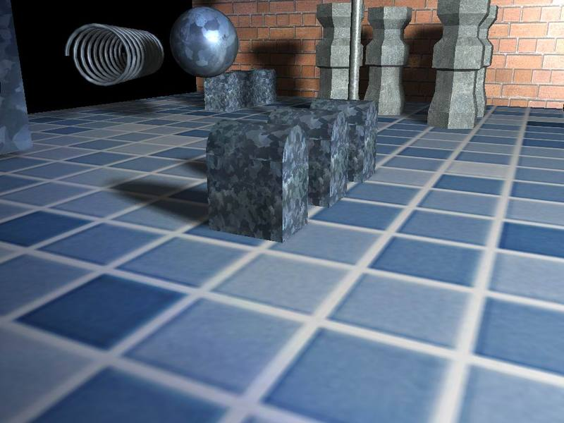

Slide 19
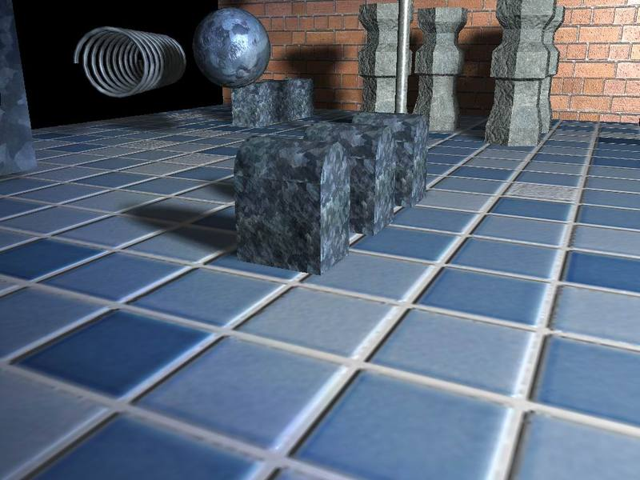

Slide 20
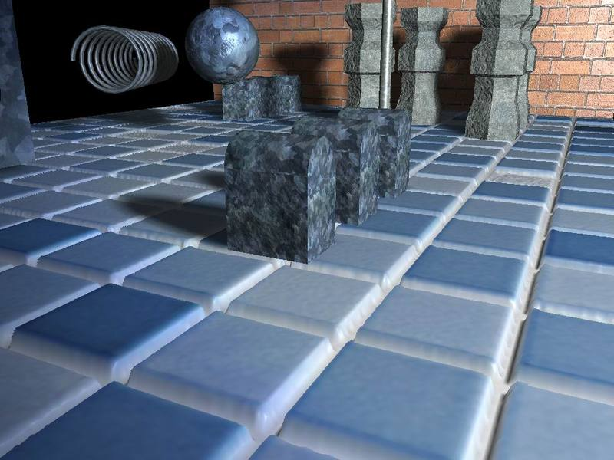

Slide 21
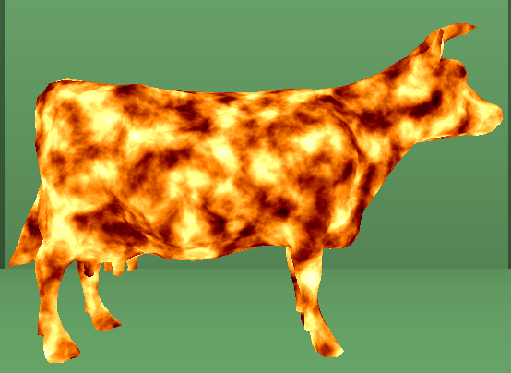


Noise
Simplex Noise - Gustavson
Need a noise function in n-dimensions:
  Map a position in to a value -1..1
  Pseudo-random - same point always returns same value
  Coherent - value changes smoothly as you move between points
Classic Perlin noise:
  0 at integer coordinates
  Gradient noise - “random” n-dimensional gradient at each grid pt
© 2005 James K. Hahn 2010 Robert Falk

Slide 22
Noise
Perlin Noise Math (Matt Zucker)
p
Implementing Improved Perlin Noise
Gradient Noise
  PIck a pseudo-random gradient for each integer coordinate
  3D gradients: 12 vectors from a cube’s center to middle of each edge
Compute noise value at P:
  Find neighboring grid points (2D->4, 3D->8...)
  Set value at each grid point to dot product of blue and red vectors
  Then interpolate ‘p’ from grid point values
© 2005 James K. Hahn 2010 Robert Falk

Slide 23
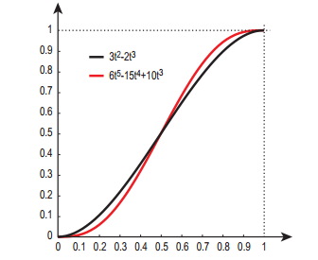
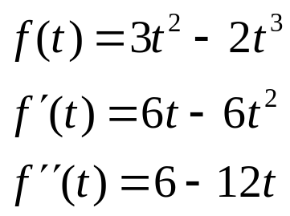
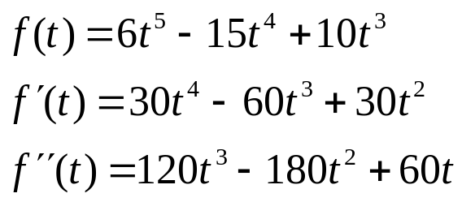
Noise
p
Interpolate from integer coordinates using 3’rd degree:
  f(0)=0, f(1) =1, f’(0)=0, f’(1)=0
  first derivative is 0 at t=0 & t=1
Or 5’th degree blending function f(t):
  f(0)=0, f(1) =1, f’(0)=0, f’(1)=0, f’’(0)=0, f’’(1)=0
  second derivative also 0 at t=0 & t=1
© 2005 James K. Hahn 2010 Robert Falk

Slide 24
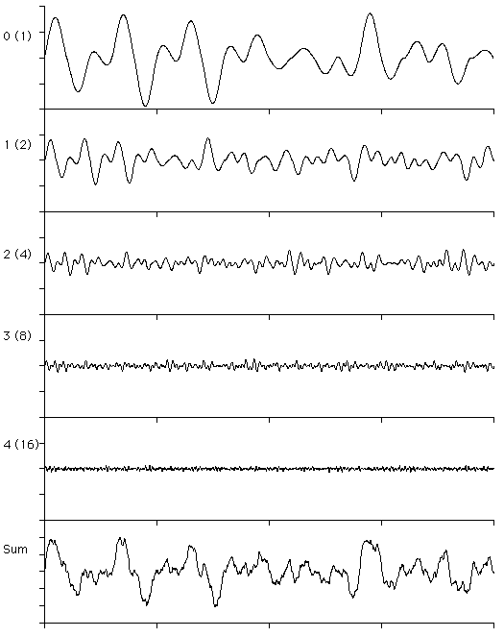
Turbulence
  Add a number of copies of the noise
  Reduce amplitude and increase frequency
  Common choice: 1/2 amplitude and double frequency each time
© 2005 James K. Hahn 2010 Robert Falk

Slide 25
Final Exam Topics
All lighting topics
  diffuse, specular and ambient lighting
  Be able to write equations for above
Rendering pipeline (with and without shaders)
Ray tracing and radiosity
Texture mapping
3D transformations (modeling transformations)
Advanced shading techniques
  procedural, cube mapping, bump mapping
© 2005 James K. Hahn 2010 Robert Falk

Slide 26

Next: Advanced Rendering
© 2005 James K. Hahn 2010 Robert Falk

